Slide 1
CS 35L – Section1
10/02/2013
Zhanyong Wang (Jerry)
zhanyongwang@ucla.edu
Office Hour:
9:00-11:00 Tuesday
BH 2432

Slide 2
The Basics: Changing File Attributes
ln: create a link
Hard links: point to physical data
Soft links aka symbolic links (-s): point to a file
touch: update access & modification time to current time
touch filename
touch -t 201101311759.30 filename
Change filename’s access & modification time to (year 2011 January day 31 time 17:59:30)

Slide 3
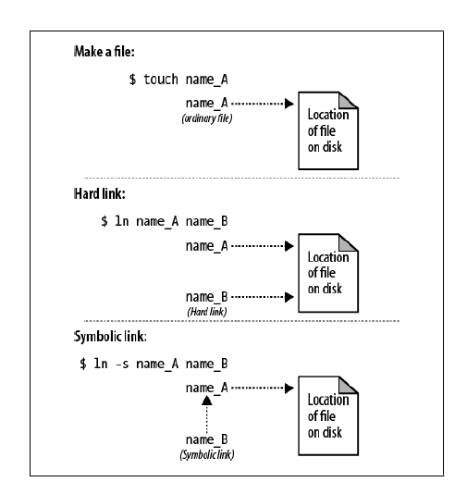
Symbolic Links vs. Hard Links

Slide 4
Difference between hard and soft links
Touch file_a
Edit file_a
Ln file_a file_b
Ln –s file_a file_c
View file_b file_c
Rm file_a
View file_b, file_c
Edit file_a(different version)

Slide 5
man
Extensive documentation that comes preinstalled with almost all substantial Unix and Unix-like operating systems
Usage
read a manual page for a Unix/Linux command
man <command_name>
man section command_name
Hit “q” to get out of man page.

Slide 6
Reading man Pages
man <command>
First Line: the command you have searched for and a number in parentheses that shows you what section of the man page you are viewing.
Man page sections are: (1) User Commands (2) System Calls (3) Library functions (4) Devices (5) File formats (6) Games and Amusements (7) Conventions and Miscellany (8) System Administration and Privileged Commands

Slide 7
Reading man Pages
Standard Headings
Name: name of the command followed by a short description of what the command does (usually one sentence or less).
Synopsis: describes how the command is supposed to be used. Example: ls [Option]…[File]…
Description: gives a more detailed definition of the command and provides the OPTIONs available for the command.

Slide 8
Reading man Pages
Other Common Headings
AUTHORS: the people who created or assisted in the creation of the command.
BUGS: lists any known defects or shortcoming of the programs.
EXAMPLES or NOTES: An illustration of how to use the command including general notes.
REPORTING BUGS: where you should report problems you’re having with the command.
COPYRIGHT: The person or organization that holds the copyright to this information; usually a disclaimer that this is free software.
SEE ALSO: Other commands that are related to this command. This section also frequently mentions any other documentation related to this command.

Slide 9
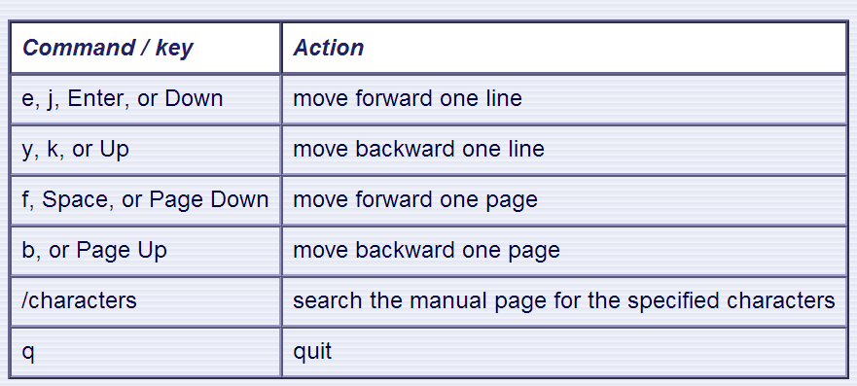
man – Moving Around
Use the following keys and commands to move around in the manual page:

Slide 10
Process: ps and kill
Process
An instance of a computer program that is being executed
ps
List processes that are currently running
kill
Terminate a certain process
Usage
kill PID

Slide 11
Cron
Daemon – process that runs in the background
Enables users to schedule jobs to run periodically at certain times (cron jobs)
Example:
Full Backup every month

Slide 12
diff
A file comparison utility that outputs the differences between two files.
Shows the changes between one version of a file and a former version of the same file
Usage
diff original_file new_file

Slide 13
Wget/cURL
A computer program that retrieves content from web servers
Usage
wget <URL>

Slide 14
vi/vim
Modes:
Command: Enter commands
Insert: Insert text
Visual: Like normal, but you can highlight
Cheat Sheet available on CourseWeb

Slide 15
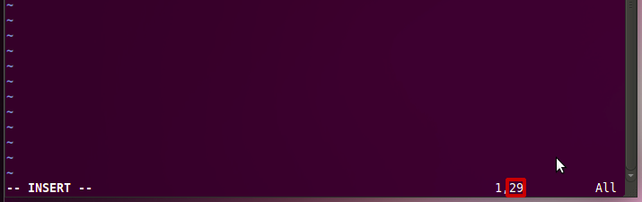
Submission Rules – Column Number Check
vi editor – insert mode
–Number inside the box is the column number

Slide 16
80 columns restriction in vi
After finishing editing
Switch to command mode by hitting ‘Esc’
:set tw=80
Type gggqG
gg: go to the beginning of buffer
gq: reformat the text included in the motion
G: go to the end of the buffer
In order to make this work the paragraph must have space character(s).
Don’t use this to edit source files.
You’ll get compile errors.

Slide 17
80 columns restriction in vi – cont’d
If you want to make the above as a macro, then create .vimrc under your home directory.
$ vim .vimrc
Type the following.
command! Wrap :set tw=80 | :normal gggqG
How to use it?
Under command mode
:Wrap

Slide 18
What is the use of option “-v” of “cp”
Lab1.txt
1.verbose, explain what is being done
Lab1.log
1. man cp
scroll down to find the explanation of “-v”

Slide 19
If you are working on the seasnet server….

Slide 20
Transferring files using MacOS
Download:
scp zhanyong@lnxsrv01.seas.ucla.edu:/w/grad.5/cs/zhanyong/CS33/C_hello/hello.c hello.c
Upload:
reverse source file and destination file

Slide 21
Transferring file using PC
WinSCP, psftp
Recommend WinSCP
Homepage: http://winscp.net/eng/index.php
Download: http://winscp.net/download/winscp510setup.exe
Host name = lnxsrv01.seas.ucla.edu
Username = your SEASnet user name

Slide 22
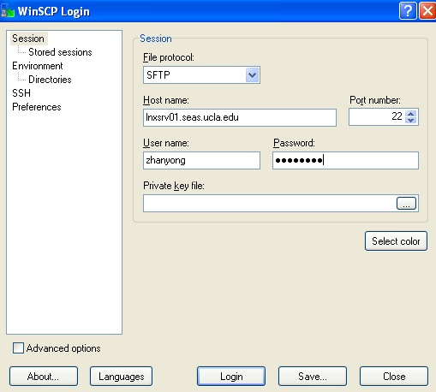
WinSCP

Slide 23
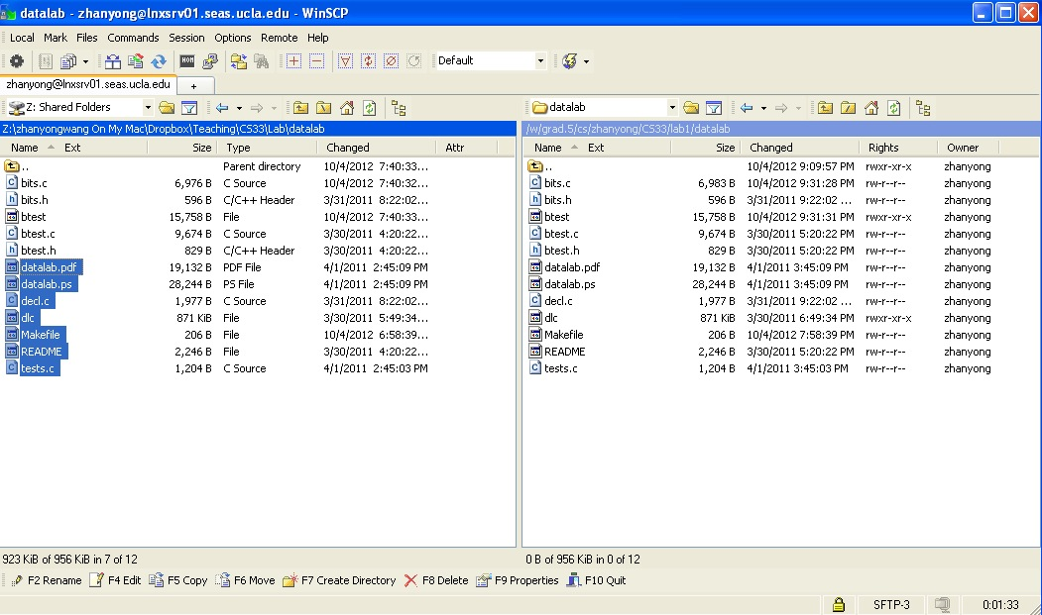
WinSCP

